Slide 1
Module 3
Programming for Blockchain
Content
3.1
Introduction to Smart Contracts, Types of Smart Contracts, Structure of a Smart Contract, Smart Contract Approaches, Limitations of Smart Contracts
TB2, Web reference
3.2
Introduction to Programming: Solidity Programming – Basics, functions, Visibility and Activity Qualifiers, Address and Address Payable, Bytes and Enums, Arrays-Fixed and Dynamic Arrays, Special Arrays-Bytes and strings, Struct, Mapping, Inheritance, Error handling
3.3
Case Study – Voting Contract App, Preparing for smart contract development

Slide 2
Smart Contracts
Smart contracts are simply programs stored on a blockchain that run when predetermined conditions are met.
They typically are used to automate the execution of an agreement so that all participants can be immediately certain of the outcome, without any intermediary's involvement or time loss.

Slide 3
Smart Contracts
Smart Contracts play a very essential role, it helps to make the transactions taking place more safe and secure and function in an organized manner.
And not just that, it helps other components like applications running on these platforms be even more accessible.

Slide 4
What Is Smart Contract?
Smart contracts are computer programs or protocols for automated transactions that are stored on a blockchain and run in response to meeting certain conditions.
In other words, smart contracts automate the execution of agreements so that all participants can ascertain the outcome as soon as possible without the involvement of an intermediary or time delay.
Smart contracts are self-executing contracts in which the contents of the buyer-seller agreement are inscribed directly into lines of code.
According to Nick Szabo, an American computer scientist who devised a virtual currency called "Bit Gold" in 1998, Smart contracts are computerized transaction protocols that execute contract conditions.
Using it makes the transactions traceable, transparent, and irreversible.

Slide 5
Benefits of Smart Contracts
Accuracy, Speed, and Efficiency
The contract is immediately executed when a condition is met.
Because smart contracts are digital and automated, there is no paperwork to deal with, and
No time was spent correcting errors that can occur when filling out documentation by hand.

Slide 6
Trust and Transparency
There's no need to worry about information being tampered with for personal gain because there's no third party engaged and
Encrypted transaction logs are exchanged among participants.

Slide 7
Security
Because blockchain transaction records are encrypted, they are extremely difficult to hack.
Furthermore, because each entry on a distributed ledger is linked to the entries before and after it, hackers would have to change the entire chain to change a single record.
Savings
Smart contracts eliminate the need for intermediaries to conduct transactions, as well as the time delays and fees that come with them.

Slide 8
How Do Smart Contracts Work?
A smart contract is a sort of program that encodes business logic and operates on a dedicated virtual machine embedded in a blockchain or other distributed ledger.
Step 1: Business teams collaborate with developers to define their criteria for the smart contract's desired behavior in response to certain events or circumstances.
Step 2: Conditions such as payment authorization, shipment receipt, or a utility meter reading threshold are examples of simple events.
Step 3: More complex operations, such as determining the value of a derivative financial instrument, or automatically releasing an insurance payment, might be encoded using more sophisticated logic.

Slide 9
How Do Smart Contracts Work?
Step 4: The developers then use a smart contract writing platform to create and test the logic. After the application is written, it is sent to a separate team for security testing.
Step 5: An internal expert or a company that specializes in vetting smart contract security could be used.
Step 6: The contract is then deployed on an existing blockchain or other distributed ledger infrastructure once it has been authorized.

Slide 10
How Do Smart Contracts Work?
Step 7: The smart contract is configured to listen for event updates from an "oracle," which is effectively a cryptographically secure streaming data source, once it has been deployed.
Step 8: Once it obtains the necessary combination of events from one or more oracles, the smart contract executes.

Slide 11
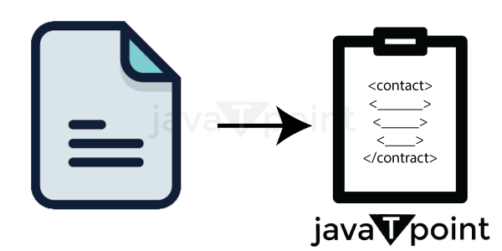

Slide 12
Smart contracts in blockchain
The majority of commercial transactions involve the signing of documents that outline the terms and circumstances of the arrangement.
Due to the handwriting, there is a potential that both parties will perceive these contacts differently.
The likelihood of a dispute growing will increase as the contract's complexity does.
As a result, having a neutral third party that can enact legislation and expedites the agreement process becomes increasingly important over time.

Slide 13
Smart contracts in blockchain
Intelligent contracts are short pieces of logic-based code that run when specific criteria are met.
You should be conscious that smart contracts have been developed for secure blockchain.
Smart contracts are used everywhere now, which increases their significance.
To keep up with technology, people are learning about blockchain smart contracts.

Slide 14
What is a smart contract?
The smart contract represents an authenticated contract with all the necessary information and has been agreed upon by both parties.
Its reasoning includes conclusions for any scenario that could arise under an agreement.
The agreement includes scenarios for both outcomes, making it more straightforward for you to settle disagreements whether it succeeds or fails.
Typically connected to Ethereum, these contracts were explicitly created to support the use of smart contracts.
However, you can easily apply this approach to any blockchain network or platform.

Slide 15
What is a smart contract?
The smart contract's code specifies how to guarantee agreement performance.
Based on the particulars set on the contract, smart contracts are automatic and self-explanatory.
The distributed ledger system (DLT) used by the blockchain, which enables data to be kept globally across several servers, mainly depends on those databases to validate a transaction.
Smart contracts are enticing because they eliminate administrative burdens.

Slide 16
What is a smart contract?
When the established conditions of a smart contract are satisfied, funds are automatically transferred from a single party to another.
This is represented by the terms and constraints expressed in codes.
For instance, if both parties agree to exchange a cryptocurrency, the exchange will be recorded on the blockchain using the smart contract's protocol.

Slide 17
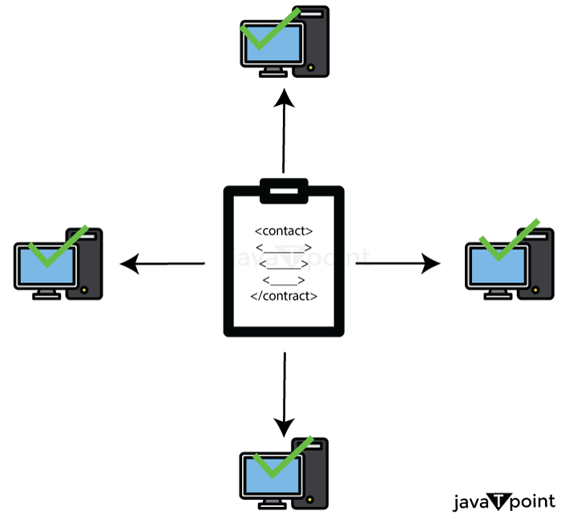

Slide 18
What is a smart contract?
Smart contracts are created using the Solidity and Go programming languages and are immutable and irrevocable.
However, despite their name, smart contracts are not enforceable in court.
Their main responsibility is to implement business logic through programming that executes different operations, processes, or transactions that are part of them depending on certain criteria.

Slide 19
Different kinds of smart contracts:
Decentralized Autonomous Organizations (DAO)
Smart Legal Contracts
Application Logic Contracts (ALC)

Slide 20
Smart Contract's History
The smart contract was first introduced to the world by American technologist Nick Szabo in 1994.
The main objectives of smart contracts, according to him, are to "satisfy common commercial conditions of use, minimize both nefarious and unintentional errors, and remove the need for trustworthy third parties."
Smart contracts are a computerized transaction protocol that performs the terms of a contract.

Slide 21
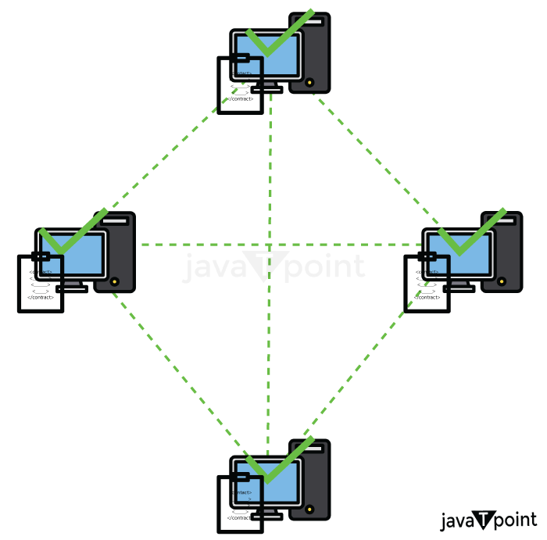

Slide 22
Smart Contract's History
Smart contracts' foundation was laid by blockchain.
The primary protocol, smart contracts, which define the requirements that must be met when transferring bitcoins between users of the network, such as having sufficient cash to make the transfer, is also supported by bitcoin.
This reasoning is seen in food machines where a particular code releases a specific snack.
Nick advocated replicating asset databases and executing contracts employing encrypted hash chains & Byzantine fault-tolerant mechanisms when he initially coined the term "Smart Contracts" in 1994.

Slide 23
What Function Do Blockchain Smart Contracts Serve?
Customers would need to transmit transactions to the blockchain in order to launch smart contracts because the program operates on the blockchain.
Only then can the program be performed when the codes have been established and the logic secured.
Smart contracts often aim to stream commercial transactions among parties by doing away with the go-betweens present in conventional business processes.
These agreements seek to lessen the complexity of typical contracts, the possibility of errors, and payment delays while maintaining their validity and reliability.
Its most characteristic benefit is that it makes it possible to conduct reliable transactions without the use of intermediaries.

Slide 24
How do Blockchain Smart Contracts are Created?
A computer mechanism known as a "smart contract" is created to form, manage, and communicate details about the asset's owner.
It is true that a program used to enable, confirm, or carry out reliable transactions autonomously operates on the Ethereum blockchain.

Slide 25
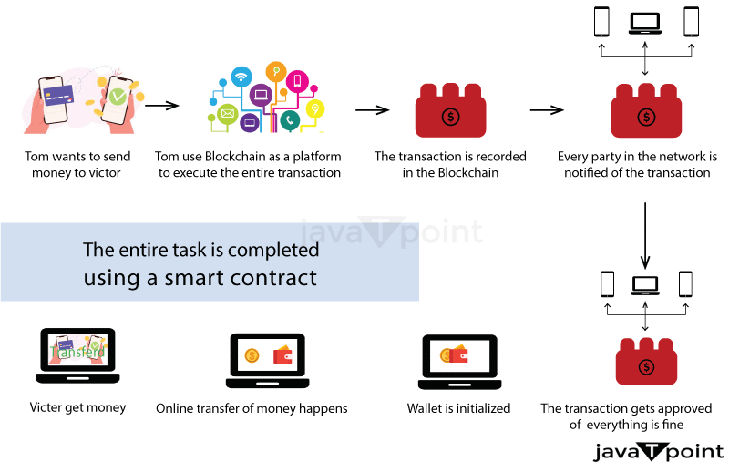

Slide 26
How do Blockchain Smart Contracts are Created?
We first need to comprehend what makes up a smart contract in order to understand how it functions.
Signatures: To proceed with the suggested regulations and conditions, a minimum of two parties must give their approval.
Identify the contract's topic critically : The topic needs to fit in with the digital contract environment. When using the terms, be precise.
The terminology must be clear and thoroughly defined.
The agreement should be in precise mathematical terms consistent with the precise language, for instance, as Ethereum's smart contract system relies on Solidity, also known and Serpent programming language.

Slide 27
How do Blockchain Smart Contracts are Created?
On the basis of an understanding between two users that is maintained on the blockchain, smart contracts will often automatically initiate an action.
Accordingly, a smart contract will control the transfers when a seller desires to sell a BTC until the BTC has been successfully transferred from one individual to another.
The money will be released at that point, and nothing will change. In addition, a public database will list and keep all of the transaction's information.

Slide 28
How do Blockchain Smart Contracts are Created?
On the basis of an understanding between two users that is maintained on the blockchain, smart contracts will often automatically initiate an action.
Accordingly, a smart contract will control the transfers when a seller desires to sell a BTC until the BTC has been successfully transferred from one individual to another.
The money will be released at that point, and nothing will change. In addition, a public database will list and keep all of the transaction's information.

Slide 29
Smart contracts' characteristics and traits
Smart contracts are well-liked because of the following traits:
Self-enforcing: It requires less human interaction and is hence enforceable. When a particular condition is satisfied, smart contracts that include logic are carried out.
Self-verify: Smart contracts that self-verify are renowned for their integrity since they verify that both parties adhere to the rules. It is going to impose an obligation on the party who violated the rules in the event of a breach.
Tamper-proof: Because the contract's terms and conditions cannot be changed, the possibility of manipulation is eliminated. If you want to change, you must create a separate block with the agreed-upon specifications.

Slide 30
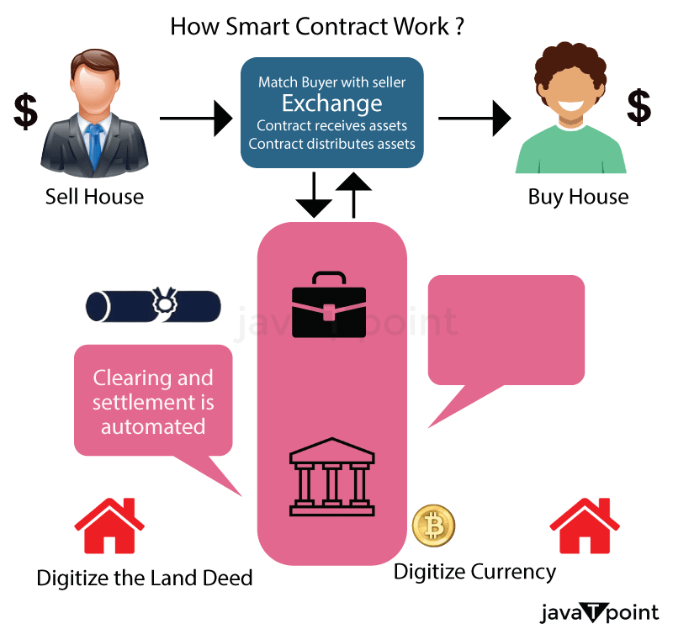

Slide 31
How Are Smart Contracts Operated?
Smart contracts are just pieces of software that describe computer protocols or, to put it another way, a core component of technology.
They serve to detail every agreement condition reached between blockchain transaction parties.
When these prerequisites are met, a smart contract will immediately execute a transaction.
As it depends on a publicly accessible ledger whereby anyone with interest can verify all transactions, a system built around the blockchain enables its members to remove intermediaries and wasteful paperwork.
The paramount necessity here is to use appropriate programming languages and mathematical methods to specify all the agreement criteria.

Slide 32
How Are Smart Contracts Operated?
Each node in the blockchain's dispersed network of nodes stores the details of every transaction. One would need to take control of over fifty percent of these various nodes in order to reverse a transaction or double-spend money.
The company works with blockchain engineers to specify what should be in the contract as well as all the rules and conditions in order to establish a smart contract. Smart contracts are used by businesses for a variety of purposes, from confirming payments to more complicated actions like determining the value of an investment, etc.
Any criterion for success can be included by businesses in smart contracts. The transactions should be approved by each signing partner. The mechanism for addressing disputes, if any, must also be included in the contract.

Slide 33
How Are Smart Contracts Operated?
Ethereum enables the development and deployment of smart contracts. A cryptographically secured streaming data source called "Oracle" is where the smart contract first begins to listen for event updates. Only when it receives the proper events via oracles does the smart contract actually go into action? On the Ethereum blockchain, smart contracts are often created using the Solidity language for programming.
Like Javascript, Solidity is a specially designed scripting language that verifies and sticks to the contract's restrictions at compile time rather than during runtime.
After processing, a smart contract is deployed to the network to carry out its function.

Slide 34
Uses of Smart Contracts
Smart contracts can be used in a variety of fields, from healthcare to supply chain to financial services. Some examples are as follows:
Government voting system
Smart contracts provide a secure environment making the voting system less susceptible to manipulation. Votes using smart contracts would be ledger-protected, which is extremely difficult to decode.
Moreover, smart contracts could increase the turnover of voters, which is historically low due to the inefficient system that requires voters to line up, show identity, and complete forms. Voting, when transferred online using smart contracts, can increase the number of participants in a voting system.

Slide 35
Uses of Smart Contracts
2. Healthcare
Blockchain can store the encoded health records of patients with a private key. Only specific individuals would be granted access to the records for privacy concerns. Similarly, research can be conducted confidentially and securely using smart contracts.
All hospital receipts of patients can be stored on the blockchain and automatically shared with insurance companies as proof of service. Moreover, the ledger can be used for different activities, such as managing supplies, supervising drugs, and regulation compliance.

Slide 36
Uses of Smart Contracts
3. Supply chain
Traditionally, supply chains suffer due to paper-based systems where forms pass through multiple channels to get approvals. The laborious process increases the risk of fraud and loss.
Blockchain can nullify such risks by delivering an accessible and secure digital version to parties involved in the chain. Smart contracts can be used for inventory management and the automation of payments and tasks.

Slide 37
Uses of Smart Contracts
4. Financial services
Smart contracts help in transforming traditional financial services in multiple ways. In the case of insurance claims, they perform error checking, routing, and transfer payments to the user if everything is found appropriate.
Smart contracts incorporate critical tools for bookkeeping and eliminate the possibility of infiltration of accounting records. They also enable shareholders to take part in decision making in a transparent way. Also, they help in trade clearing, where the funds are transferred once the amounts of trade settlements are calculated.

Slide 38
Benefits of Smart Contracts
Autonomy and savings
Smart contracts do not need brokers or other intermediaries to confirm the agreement; thus, they eliminate the risk of manipulation by third parties. Moreover, the absence of intermediary in smart contracts results in cost savings.
2. Backup
All the documents stored on blockchain are duplicated multiple times; thus, originals can be restored in the event of any data loss.

Slide 39
Benefits of Smart Contracts
3. Safety
Smart contracts are encrypted, and cryptography keeps all the documents safe from infiltration.
4. Speed
Smart contracts automate tasks by using computer protocols, saving hours of various business processes.
5. Accuracy
Using smart contracts results in the elimination of errors that occur due to manual filling of numerous forms.

Slide 40
Limitations of Smart Contracts
Difficult to change
Changing smart contract processes is almost impossible, any error in the code can be time-consuming and expensive to correct.
2. Possibility of loopholes
According to the concept of good faith, parties will deal fairly and not get benefits unethically from a contract. However, using smart contracts makes it difficult to ensure that the terms are met according to what was agreed upon.

Slide 41
Limitations of Smart Contracts
3. Third party
Although smart contracts seek to eliminate third-party involvement, it is not possible to eliminate them. Third parties assume different roles from the ones they take in traditional contracts. For example, lawyers will not be needed to prepare individual contracts; however, they will be needed by developers to understand the terms to create codes for smart contracts.
4. Vague terms
Since contracts include terms that are not always understood, smart contracts are not always able to handle terms and conditions that are vague.

Slide 42
Limitations of Smart Contracts
3. Third party
Although smart contracts seek to eliminate third-party involvement, it is not possible to eliminate them. Third parties assume different roles from the ones they take in traditional contracts. For example, lawyers will not be needed to prepare individual contracts; however, they will be needed by developers to understand the terms to create codes for smart contracts.
4. Vague terms
Since contracts include terms that are not always understood, smart contracts are not always able to handle terms and conditions that are vague.

Slide 43
Introduction to Solidity Programming
Solidity is a high-level programming language designed for implementing smart contracts. It is statically-typed object-oriented(contract-oriented) language.
Solidity is highly influenced by Python, c++, and JavaScript which runs on the Ethereum Virtual Machine(EVM).
https://youtube.com/playlist?list=PLO5VPQH6OWdVQwpQfw9rZ67O6Pjfo6q-p
https://youtube.com/playlist?list=PL-Jc9J83PIiG6_thChXWzolj9BEG-Y0gh
.SOL
Solidity Files are saved with the .sol extension to indicate that it is a solidity file.
PRAGMA
- The first line of a solidity file is the pragma statement. It indicates the solidity version that is being used. It helps ensure compatibility in code files.
Pragma solidity ^ 0.8.2;

Slide 44
Introduction to Solidity Programming
CONTRACT
This keyword is used to create a smart contract.
By convention the name of the contract is usually the name of the solidity file. Every function and variable declaration in the file will be encapsulated within the smart contract.
Contract Test {
Function and data
}

Slide 45
Introduction to Solidity Programming
VARIABLES
variables are reserved memory locations to store value. You may like to store information of various data types like character, wide character, integer, floating point, double floating point, boolean etc. Based on the data type of a variable, the operating system allocates memory and decides what can be stored in the reserved memory. examples of variables are-- integer,string,bool.
State variable can possess qualifiers such as
Internal
Private
Public
constant

Slide 46
Introduction to Solidity Programming
Functions
Functions play a crucial role in any programming language and is same applicable for solidity programming.
Ethereum maintain state variable’s current state and execute transactions to change the values in state variables.
When in a smart contract is invoked, it results in transaction creation.

Slide 47
Introduction to Solidity Programming
Fall back Functions
None of the other functions match the function identification or no data provided with function call, the solidity fallback function is called.
A contract can have only one unnamed function, which is executed anytime the contracts get plain ether without any data.
To receive ether and add it to the contract’s total balance , the fallback function

Slide 48
Introduction to Solidity Programming
ADDRESS
This is a variable type that holds the 20 byte value representing the size of an Ethereum address.
address x= 0x212;

Slide 49
Case Study – Voting Contract App, Preparing for smart contract development
https://www.freecodecamp.org/news/developing-an-ethereum-decentralized-voting-application-a99de24992d9/
https://coinmarketcap.com/currencies/bitcoin/
https://www.bitcoin.com/get-started/how-bitcoin-transactions-work/

